Slide 1

Mini Project-II (ID201B) Even Semester Session 2024-25
Expense Tracker
Aanchal (202410116100002)
Akansha Tomar(202410116100013)
Akansha Tyagi(202410116100014)
Deepu Kumari(202410116100057)
Project Supervisor:
Dr. Vipin Kumar
Assistant Professor

Slide 2
Content
Introduction
Literature Review
Objective of the Project
Technology
Hardware Requirements (Development Environment, Server requirement (if required), Client requirement (if required).
Software Requirements
Modules
Workflow
Reports
References
Notes:
Font Styles: Times New Roman + Font Size: 25

Slide 3
Introduction
An expense tracker is a tool designed to help individuals and businesses monitor their spending habits. By systematically recording and categorizing expenses, users can gain valuable insights into their financial behavior.
The primary purpose of an expense tracker is to foster awareness and control over your finances. It empowers you to make informed decisions about your spending, identify areas where you can cut back, and ultimately, work towards your financial goals.
The website focuses on building a Expense Tracker application using the MERN stack, which includes MongoDB, Express.js, React, and Node.js.
It covers both front-end and back-end development, making it a comprehensive resource for those new to full-stack development.

Slide 4
Literature Review
The expense tracking is a vital practice for effective financial management. Both manual and digital expense trackers offer unique advantages, with digital solutions providing enhanced features that promote user engagement.
As financial literacy continues to be a critical issue, the role of expense trackers in fostering financial awareness and control cannot be overstated.
Future research should explore the long-term impacts of expense tracking on financial behavior and well-being, as well as the development of innovative tools that cater to diverse user needs.

Slide 5
Objective of the Project
To provide users with a comprehensive view of their spending habits, enabling them to understand where their money goes and identify areas for improvement.
To encourage users to save money by tracking their expenses and identifying unnecessary expenditures, ultimately helping them reach their financial goals (e.g., emergency funds, vacations, investments).
To offer users visual reports and analytics (e.g., charts, graphs) that summarize their spending trends over time, helping them to recognize patterns and make adjustments as needed.
To design an intuitive and accessible interface that allows users to easily input, track, and analyze their expenses..
Notes:
Font Styles: Times New Roman + Font Size: 25

Slide 6
Technology (Hardware Requirements)
For Desktops/Laptops:
Computer to access the application by the user:
Processor: Intel Core i3 or equivalent (recommended: i5 or better)
RAM: Minimum 4 GB (recommended 8 GB or more)
Storage: SSD preferred for faster performance (minimum 256 GB).
Operating System: Windows 10 or higher, macOS, or a suitable Linux distribution.
Notes:
Font Styles: Times New Roman + Font Size: 25

Slide 7
Technology (Hardware Requirements)
For Server :
Server Specifications:
Processor: Multi-core processor (Intel Xeon or equivalent)
RAM: Minimum 8 GB (recommended 16 GB or more)
Storage: RAID setup preferred for redundancy (minimum 500 GB SSD).
Network: High-speed internet connection with good bandwidth.
Backup Solutions: External drives or cloud-based solutions for data backup.
Notes:
Font Styles: Times New Roman + Font Size: 25

Slide 8
Technology (Software Requirements)
Frontend Development:
React.js: Framework for building the user interface.
HTML5, CSS3, and JavaScript (ES6+): Standard web technologies for structure and interactivity.
Tailwind CSS (or any modern CSS framework): For styling and responsive design.
VS Code (or any IDE like WebStorm): Integrated Development Environment for writing and debugging code.
Backend Development:
Node.js: Environment for server-side logic.
Express.js: Framework for building web applications and APIs in Node.js.
MongoDB: NoSQL database for storing user data and application state.
Mongoose: ODM for interacting with MongoDB.
Notes:
Font Styles: Times New Roman + Font Size: 25

Slide 9
Modules(For User side)
User Registration and Authentication
Sign Up/Login: Allow users to create accounts and log in securely.
Password Recovery: Enable users to reset their passwords if forgotten.
Dashboard
Overview of Finances: Display a summary of total income, expenses, savings, and budget status.
Visual Analytics: Provide charts and graphs to visualize spending patterns and trends.
Expense Tracking
Add Expense: Allow users to input new expenses, including amount, category, date, and notes.
Edit/Delete Expense: Enable users to modify or remove existing entries.
Reminders and Alerts
Bill Reminders: Notify users of upcoming bills and payment deadlines.
Budget Alerts: Alert users when they are nearing or exceeding their budget limits.
Notes:
Font Styles: Times New Roman + Font Size: 25

Slide 10
Modules(For Admin side)
Admin Dashboard
Overview of User Activity: Display statistics on user registrations, active users, and overall app usage.
System Health Monitoring: Monitor the performance and health of the application.
Content Management
FAQs and Help Resources: Manage and update help documentation, FAQs, and tutorials for users.
Blog/News Section: Post updates, tips, and articles related to personal finance.
Security and Compliance
User Data Management: Ensure compliance with data protection regulations (e.g., GDPR).
Access Control: Manage permissions and access levels for different admin roles.
Notes:
Font Styles: Times New Roman + Font Size: 25

Slide 11
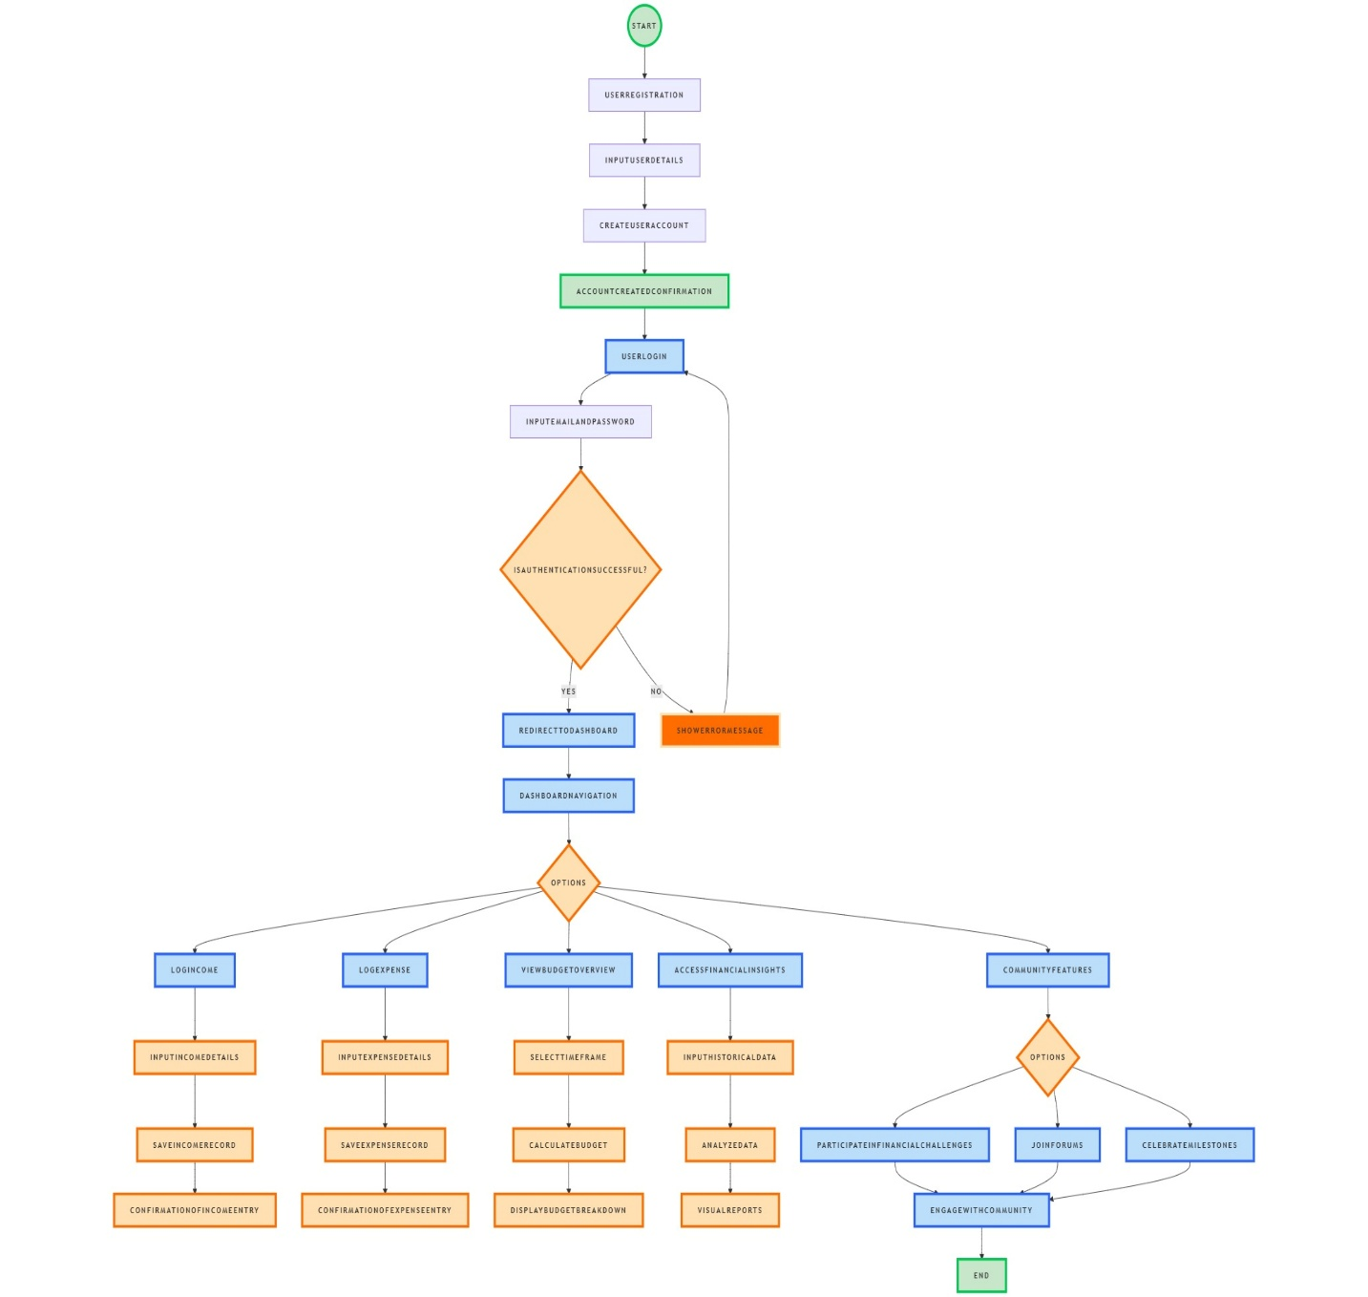
Workflow/Gantt Chart
Notes:
Font Styles: Times New Roman + Font Size: 25

Slide 12
Workflow/Gantt Chart
Notes:
Font Styles: Times New Roman + Font Size: 25

Slide 13
References
https://www.wikipedia.org/
https://www.geeksforgeeks.org/
https://openai.com/index/chatgpt/
Https://www.youtube.com/
https://dribbble.com/
Notes:
Font Styles: Times New Roman + Font Size: 25

